Slide 1
UNNAT BHARAT ABHIYAN
ઉન્નત ભારત અભિયાન
PARTICIPATING INSTITUTE MEETING : 18th JANUARY, 2020
REGIONAL COORDINATING INSTITUTE
SARDAR VALLABHBHAI NATIONAL INSTITUTE OF TECHNOLOGY, SURAT

Slide 3
Background & Need
Urbanization and centralized technologies increases inequity and climate change due to rapid ecological degradation.
To ameliorate these problems, it is necessary to promote development of rural areas in tune with the Mahatma Gandhiji’s vision of self-sufficient “Village Republic” based on local resources and using decentralized, eco-friendly technologies, and education are locally met.
Presently, around 70% of population in India lives in rural areas engaged in an agrarian economy with agriculture and allied sector employing 51% of total work-force but accounting for only 17% of total country’s GDP.
There are huge development disconnects between the rural and urban sectors such as inequity in health, education, incomes and basic amenities as well as employment opportunities-all causing great disconnect and large-scale migration to urban areas.
Unnat Bharat Abhiyan has been conceived to explore the potential of higher educational institutions to enrich rural India.

Slide 4
VISION : “To involve the reputed higher educational institutions (technical/ non-technical/ public/ private) of the country in the process of indigenous development of self-sufficient and sustainable village clusters.
MISSION : In accordance with above mentioned vision, Unnat Bharat Abhiyan will strive to pursue the following:
Develop the necessary mechanism and proper coordination among educational institutions implementation agencies (District Administration / Panchayat Raj Institutions ) and the grass root level stakeholders to enable effective at the field level.
Select suitable rural clusters and effectively participate in the holistic development of these clusters using eco-friendly sustainable technologies and local resources creating sufficient employment opportunities in the process, harnessing multifarious government schemes, Customized use of existing technologies and the use of knowledge as per the local needs, to improve the livelihood of the rural masses will be the key intervention.
Reorienting the academic curricula and research programs in higher educational institutions to make them more in alignment with the local needs to bring in holistic development.

Slide 5
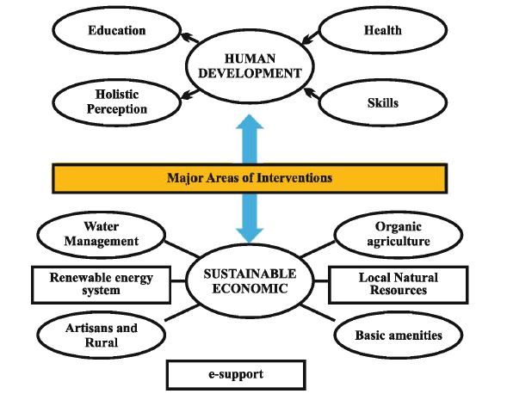
Major Area of Intervention in Sustainable Rural India Development
1. Human Development
Health
Education and Culture
Values
Skills and Entrepreneurship
2. Economic Development
Organic agriculture
Water management and conservation
Renewable energy sources
Artisans and rural industries
Development and harnessing of local natural resources
Basic amenities
E-Support (IT - enabling)

Slide 6
UNNAT BHARAT ABHIYAN

Slide 7
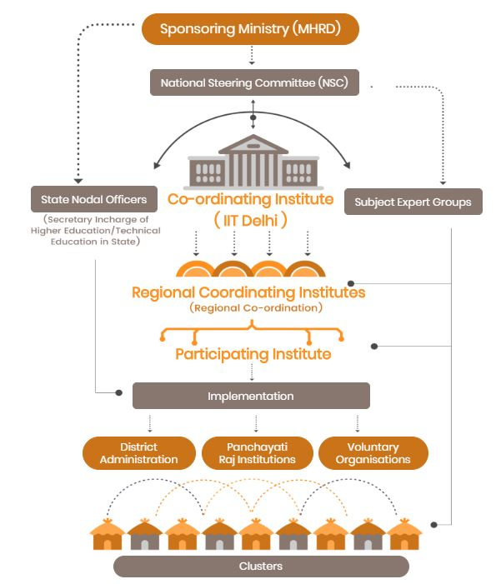
UNNAT BHARAT ABHIYAN
Total Participating Institutes in UBA : 2482

Slide 8
UBA Regional Coordinating Institute
UBA National Coordinating Institute
Indian Institute of Technology, IIT Delhi is a National Coordinating Institute for Unnat Bharat Abhiyan Scheme.
The NCI has overall responsibility in selection, training of institutions, constituting the Subject Expert Groups and monitoring the program through a web portal.
They are accountable for successful implementation of the UBA as per the objectives of program.
These institutions will act as nodal centers for promoting, guiding, monitoring & facilitate UBA network in their region.
These will be responsible for grooming the other participating institutions in their region in addition to carrying out their own village cluster activities.
The RCIs have a strategic role to play, they have to identify a challenge relevant in their region / states in collaboration with PIs and State government.

Slide 9
Eligibility & Documents required for filling Unnat Bharat Abhiyan PIs Registration :
Eligibility Section
Any recognized Higher Educational Institutions (central & State) willing to be involved in development activities.
Should have at least 200 students.
Willing to identify at least 5 villages in their vicinity.
Should have at least 2 faculty members willing to involve with development activities in rural areas.
The application received shall be ranked based on selection criteria setup by the ministry. Those who qualify the cutoff point will be selected.
Documents/Information required for filling UBA application form
Letter to DC
Institutional Bank details/Mandate form
Valid AISHE code.
Coordinator and Head of the Institution Information.
Valid Email Id and Contact number.
Number and name of Villages proposed to be adopted.

Slide 10
Role of UBA Participating Institute
The Participating Institute is expected to closely coordinate with the State Government/ District Administration / Panchayat Raj Institutions / other stakeholders including voluntary organizations with intention to:
Understand needs of selected villages
Explore the possibilities of customization existing technologies / need of develop a technology / improving the implementation mechanism of existing government schemes as per local needs
Explore the possibilities of getting fund support from District Administration / Panchayat Raj Institutions / other sources, apart of internal resources of institute
Preparing an action plan accordingly, for the selected villages to enrich rural life, with close coordination with all stakeholders
Implementation of the action plan in coordination with local administration and other stakeholders

Slide 11
UBA funds for Participating Institutes
Funds for meeting, survey, visits etc @ Rs. 10000.00 per village (Rs. 50,000/- for 5 Villages)
Transportation & food expenses for conducting Village household surveys & Village Survey
Organizing of needful workshops in villages to help villagers on village development themes.
Village survey & meeting with Gram Panchayat to identify village problems and preparation of sustainable solution proposals
Technology Development : Rs. 1.0 lakh per technology
Technology Customization : Rs. 50000.0 per solution

Slide 12
SUBJECTS : TECHNOLOGY DEVELOPMENT & TECHNOLOGY CUSTOMISATION PROPOSALS
Capacity Building, Strategy for Convergence and Implementation of Various Government Schemes
Curriculum Reforms and Educational Institutions Social Responsibility
Ethos in Technical Institutions
Liquid Waste Management
Others
Participation in School Education
Rural Craft and Artisans Development & Rural Industrialization & Entrepreneurship Development
Rural Energy Systems
Rural Infrastructure
Sanitation & Solid Waste Management
Sustainable Agriculture System
Water Resource Management

Slide 13
SUBJECT EXPERT GROUP

Slide 14
UNNAT BHARAT ABHIYAN
Stakeholders of Rural Development
Government of India
State Government
District Administration
District Panchayat Office
Taluka Panchayat Office
Gram Panchayat
Villagers
Participating Institute ( Faculty members, Staff members & Students)
Subject Expert Groups
Voluntary Organizations
NGOs

Slide 15
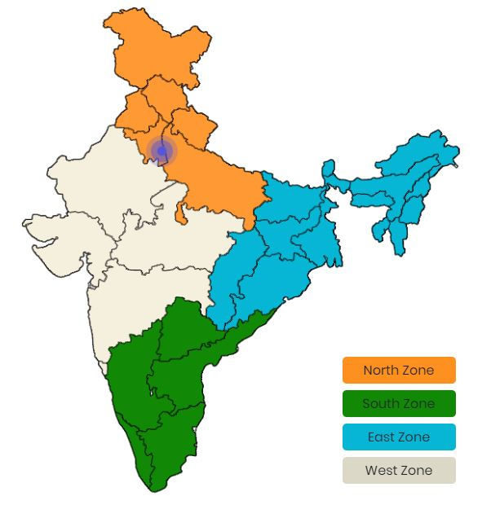
UNNAT BHARAT ABHIYAN
Indian Institute of Technology, Delhi is National Coordinating Institute
Total 40 Regional Coordinating Institute for all 28 States of the India
Total 2482 Participating Institute in Unnat Bharat Abhiyan

Slide 16
North Zone
West Zone
Sr. No. | Name of RCI
1 | NIT Kurukshetra
2 | NIT Shrinagar
3 | NIT Hamirpur
4 | NITTTR Chandigarh
5 | IIT Roorkie
6 | IIT BHU
7 | IIT Kanpur
8 | Dayalbagh Educational Institute of Agriculture
Sr. No. | Name of RCI
1 | IIT Gandhinagar
2 | IIT Mumbai
3 | Dr. Babasaheb Ambedkar Marathawada University
4 | Sant Gadge Baba Amravati University
5 | IIT Jodhpur
6 | MNIT Jaipur
7 | MPUAT Udaipur
8 | SGSIT Indore
9 | MANIT Bhopal
10 | SVNIT Surat
South Zone
Sr. No. | Name of RCI
1 | NIRD & PR Hyderabad
2 | MGNCRE
3 | NIT Warangal
4 | Andhra University
5 | Shri Venkateshwara Veterinary University
6 | IIT Madras
7 | Gandhigram Rural Institute
8 | Tamil Nadu Agriculture University
9 | Kerala Agriculture University
10 | IISER Thiruvanathapuram
11 | IISc Bangalore
12 | Karnataka University
East Zone
Sr. No. | Name of RCI
1 | NIT Raipur
2 | IIT Kharagpur
3 | NIT Durgapur
4 | NIT Jamshedpur
5 | NIT Raurkela
6 | IIT Guwahati
7 | NIT Manipur
8 | NIT Agratala
9 | NERIST
10 | NIT Patna

Slide 17
List of Districts under Regional Coordinating Institute, SVNIT, Surat & IIT Gandhinagar
RCI SVNIT Surat
Sr. No. | Name of District
1 | Anand
2 | Aravali
3 | Bharuch
4 | Chhota Udepur
5 | Dahod
6 | Dangs (Ahwa)
7 | Kheda (Nadiad)
8 | Mahisagar
9 | Navsari
10 | Panch-Mahal (Godhara)
11 | Surat
12 | Tapi (Vyara)
13 | Vadodara
14 | Valsad
15 | Narmada (Rajpipala)
16 | Daman
17 | Diu
RCI IIT Gandhinagar
Sr. No. | Name of District
1 | Ahmedabad
2 | Amroli
3 | Banaskatha
4 | Bhavanagar
5 | Botad
6 | Devbhoomi Dwarka
7 | Gandhinagar
8 | Gir Somnath
9 | Jamnagar
10 | Junagadh
11 | Katch
12 | Mehsana
13 | Morbi
14 | Patan
15 | Porbandar
16 | Rajkot
17 | Sabarkatha
18 | Surendranagar
At present, RCI SVNIT Surat is working with total 40 Participating Institutes.
IIT Gandhinagar is working with total 41 Participating Institutes.

Slide 18
JOIN UBA

Slide 19
JOIN UBA

Slide 21
Filling up the online form

Slide 22
Letter to DC (District Collector)

Slide 23
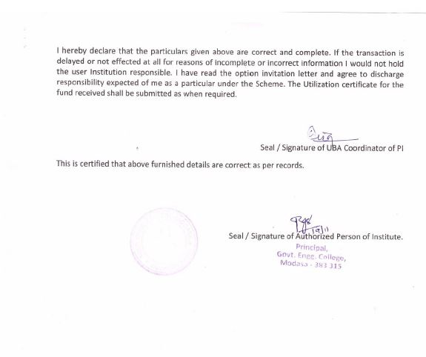
Mandate Form

Slide 24
Procedure

Slide 28
Anroid App for uploading of Household Survey

Slide 30
TECHNOLOGY DEVELOPMENT

Slide 36
TECHNOLOGY CUSTOMIZATION

Slide 39
UBA SVNIT, SURAT

Slide 40
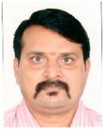
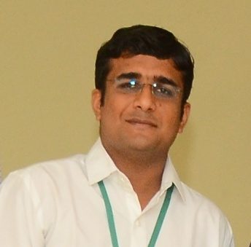
UNNAT BHARAT ABHIYAN
REGIONAL COORDINATING INSTITUTE
SARDAR VALLABHBHAI NATIONAL INSTITUTE OF TECHNOLOGY, SURAT
UBA Regional Coordinator UBA Regional Co-coordinator UBA Manager
Dr. K. D. Yadav Dr. Manish K. Rathod Er. Jaydip N.Vora
Email: kdy@ced.svnit.ac.in Email: mkr@med.svnit.ac.in Email: jaydip.uba@gmail.com
✆: +91 94283 98266 ✆: +91 99040 03856 ✆: +91 75674 24651
Address: 307, New CRC, Ichchhanath, Dumas Road, SVNIT, Surat
Ph.: 0261 220 4303

Slide 41
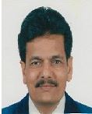
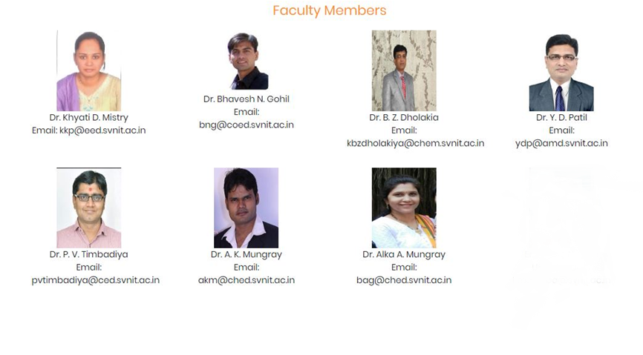
UNNAT BHARAT ABHIYAN CELL
SARDAR VALLABHBHAI NATIONAL INSTITUTE OF TECHNOLOGY, SURAT
UBA Coordinator UBA Co-coordinator
Dr. Krupesh A. Chauhan Dr. Shweta N. Shah
✆: +91 97277 12357 ✆: +91 99254 58497

Slide 42
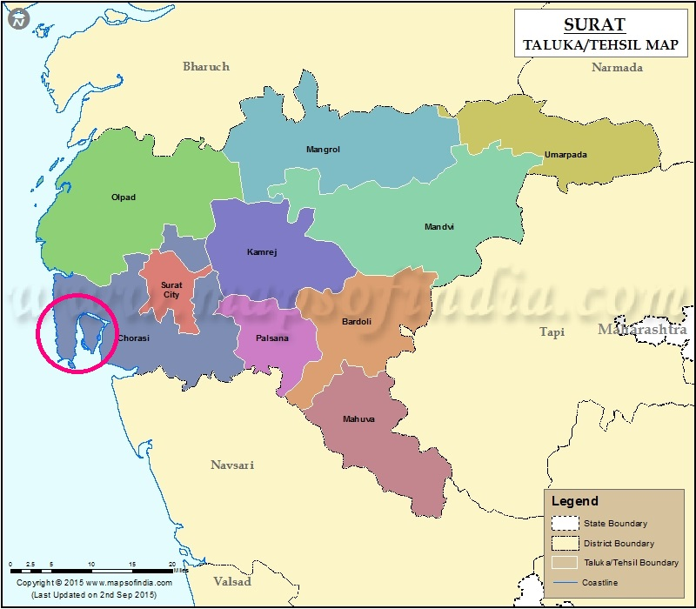
UBA Participating Institute : SVNIT, Surat
Sardar Vallabhbhai National Institute of Technology, Surat had became Participating Institute in Unnat Bharat Abhiyan on 28th December, 2016 and have adopted 5 Villages of Choryasi Taluka, Surat District for sustainable rural development.
Mora
Rajagari
Suvali
Junagam
Bhatlai

Slide 43
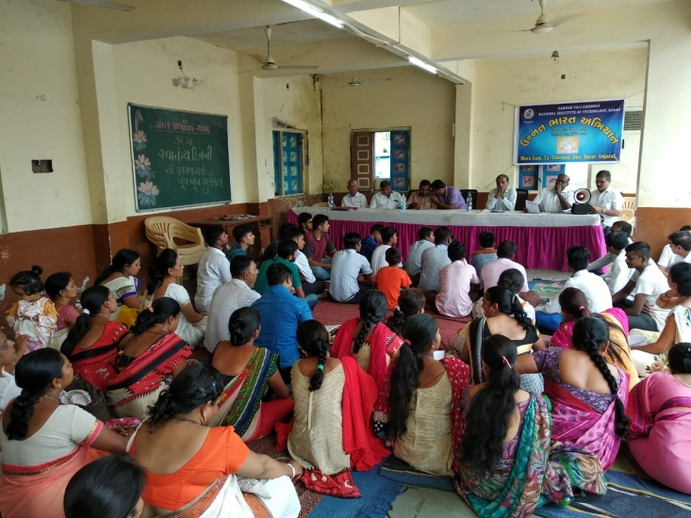
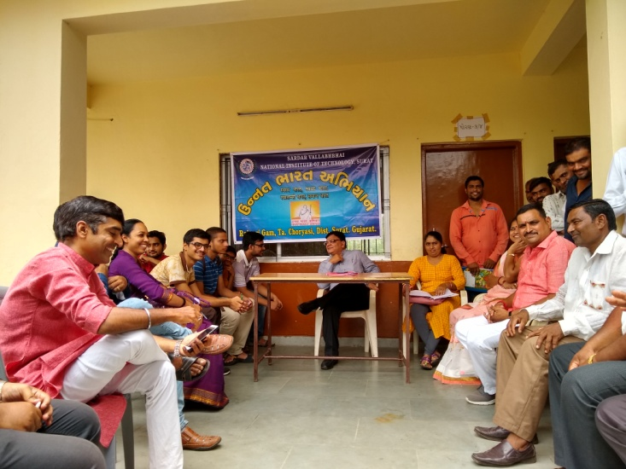
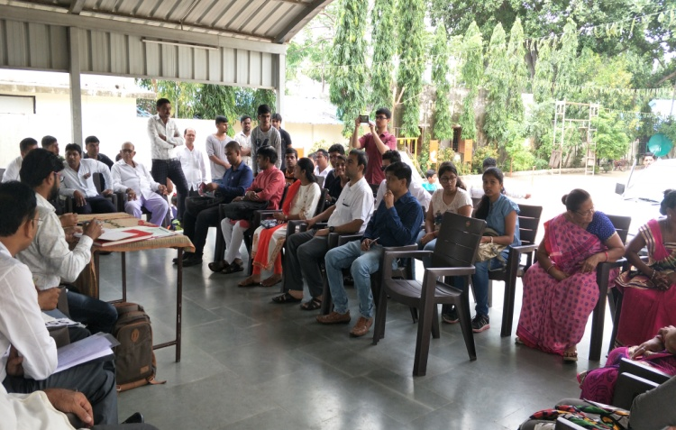
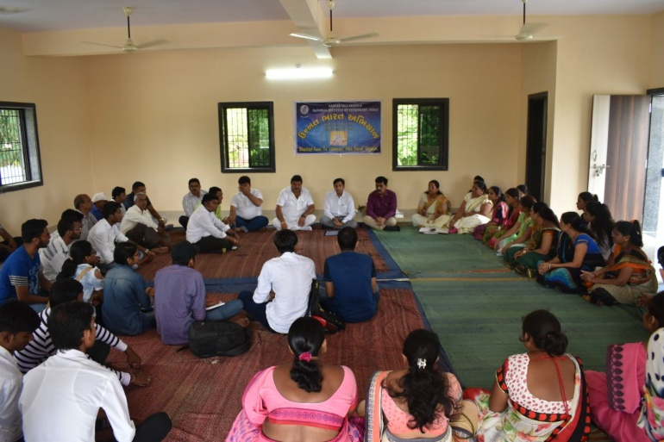
Highlights of completed activities of UBA SVNIT, Surat
1. Conducted the Village household surveys & Village surveys and meeting with Gram Panchayat

Slide 44
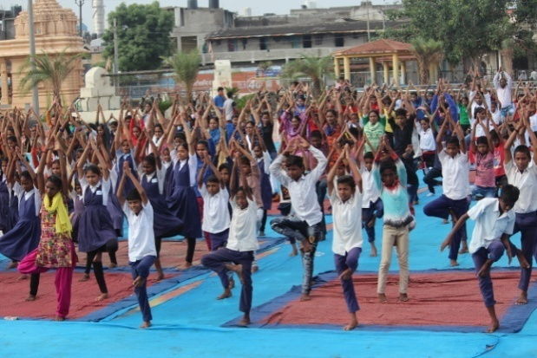
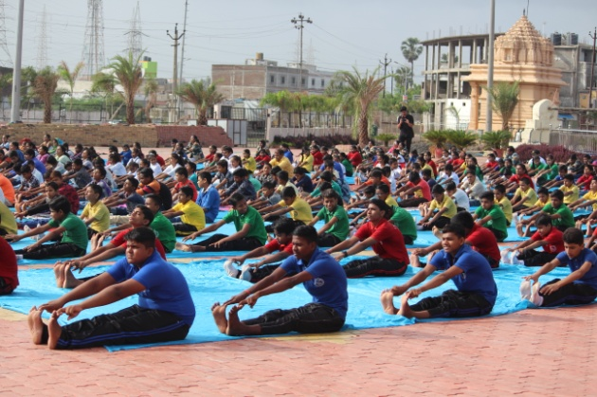
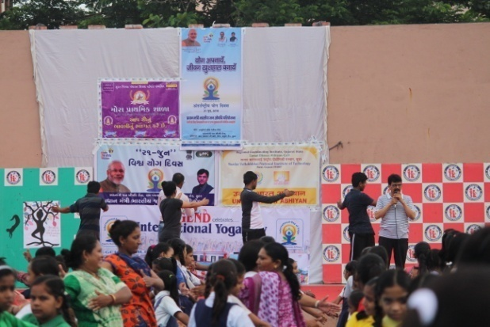
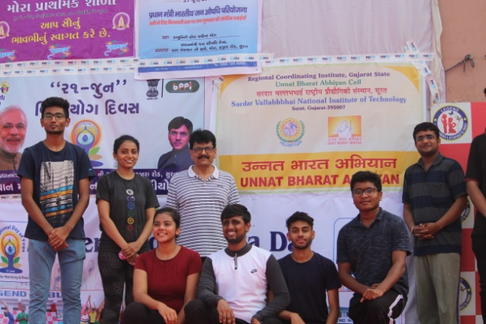
2. Celebration of World Yoga Day at 3 Schools of Mora Village

Slide 45
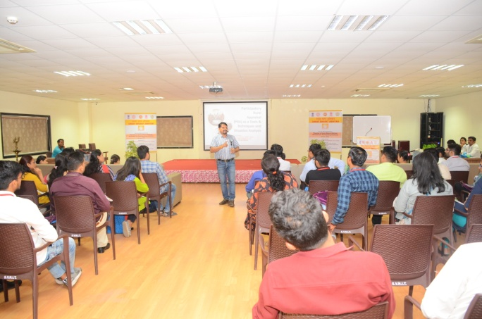
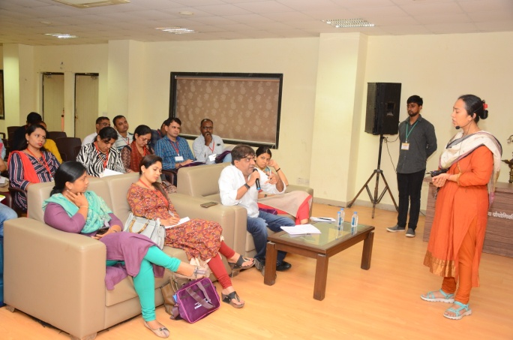
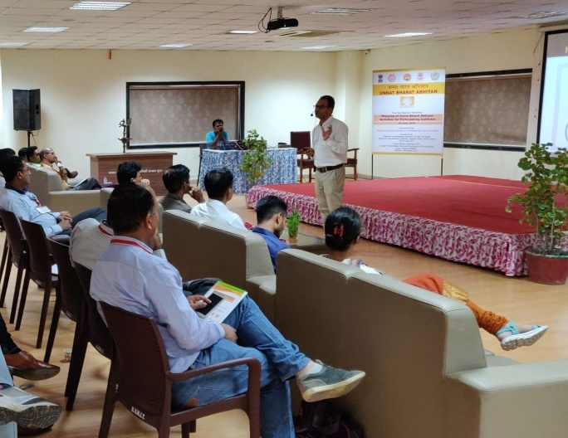
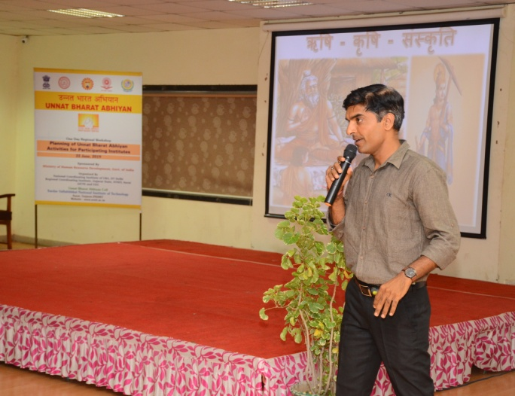
3. UBA RCI, SVNIT held one day regional workshop on “Activities Planning of Unnat Bharat Abhiyan for Participating Institute” on 22nd June, 2019 at SVNIT, Surat

Slide 46
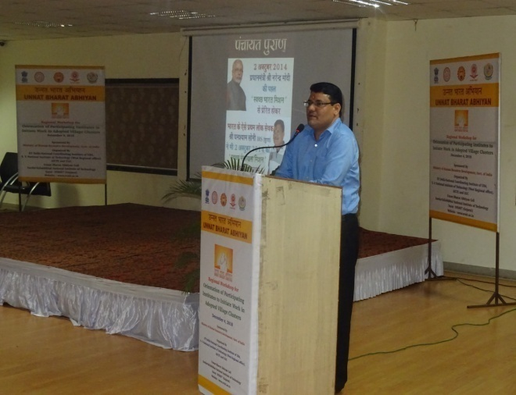
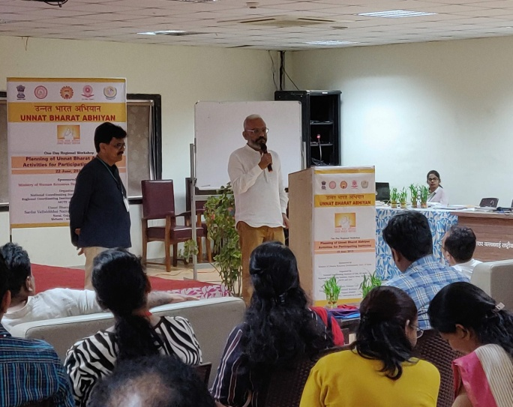

Slide 47
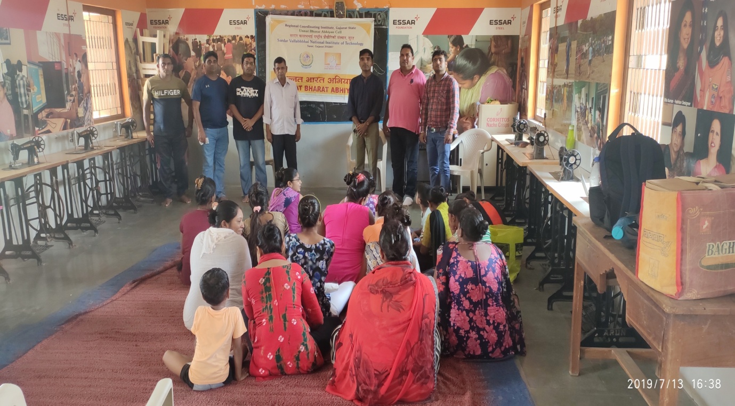
4. Organise workshop on “Jaivik Kheti & Arogya” at Junagam Community Hall, Junagam
Guide : Shri Jiteshbhai Soni ( Subject Expert)
POINT OF DISCUSSION :
Current scenario of Chemical fertilizer usage and its disadvantage related to health problems like Diabetes, Blood pressure, Cancer etc.
What is Organic Farming and how to make the Organic Fertilizer and Organic “Desi” pesticides
How to remain fit and healthy by practising good eating habits according to weather conditions
Guidance about household diagnosis by readily available vegetables and other herbal plants
Rural entrepreneurship by selling Cow Milk into the Urban area

Slide 48
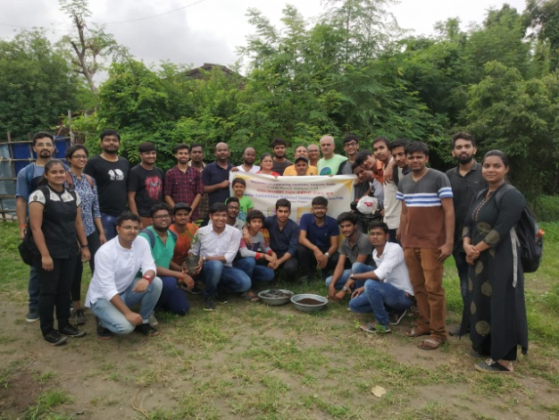
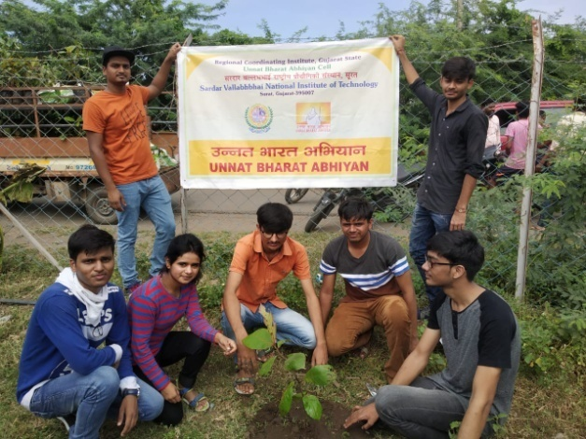
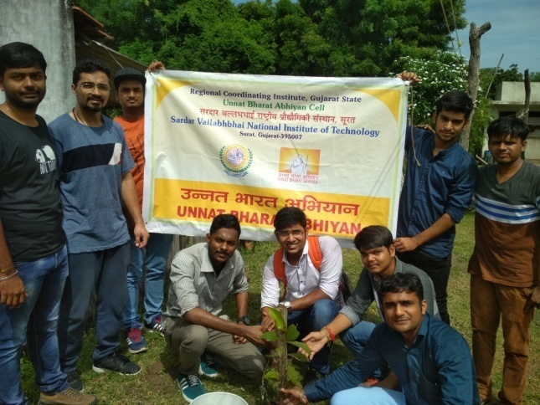
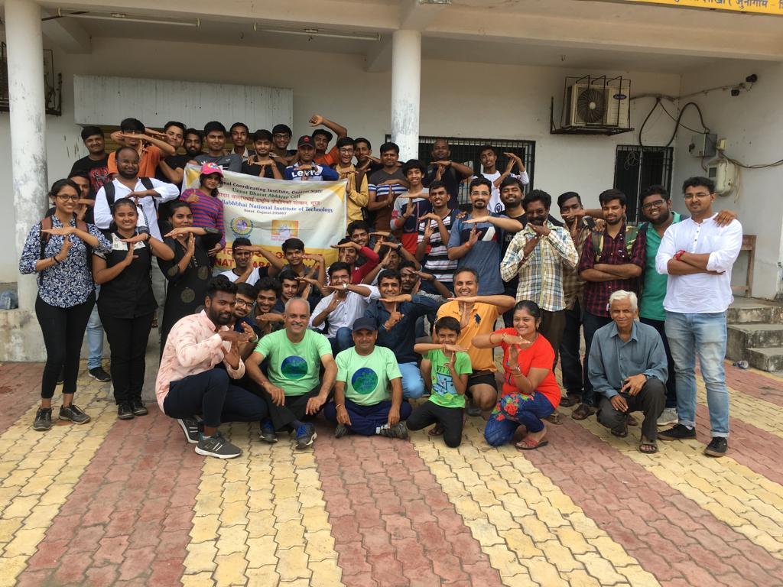
5. Native Tree Plantation with “Grow Native Green” organisation, Surat at Junagam Village : Planting the trees of Badam, Jambuda, Saragava, Vad, Pipal

Slide 49
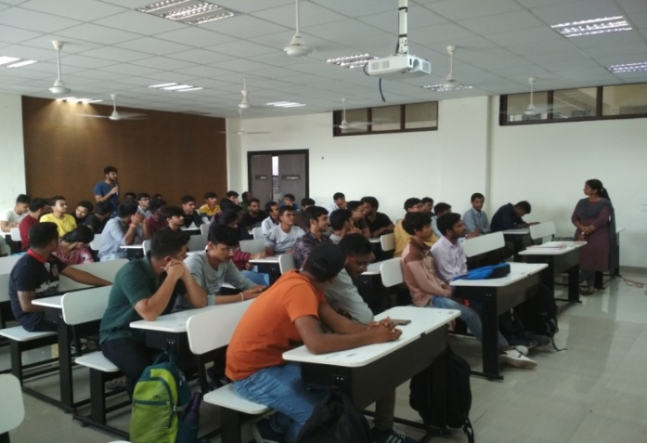
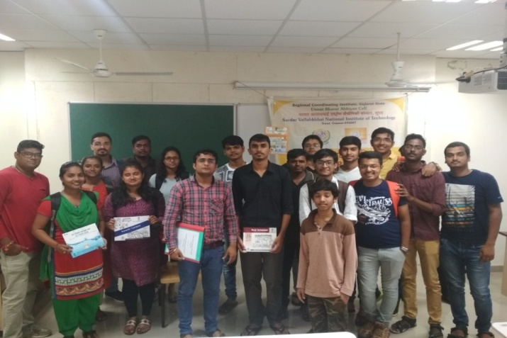
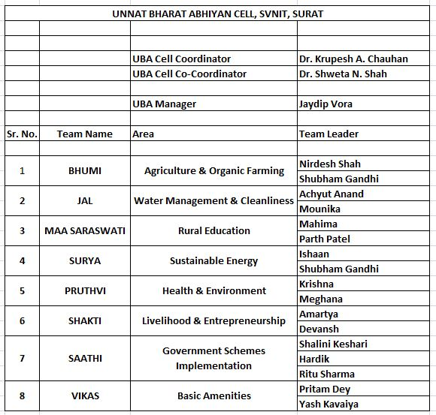
6. Organising a “Student’s General Meeting” at SVNIT, Surat and Forming 8 Teams according to area of work for Rural Development

Slide 50
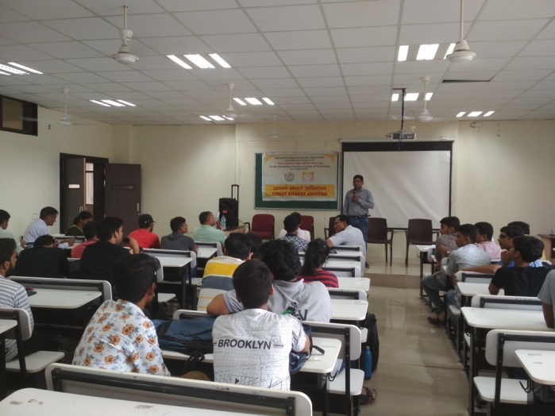
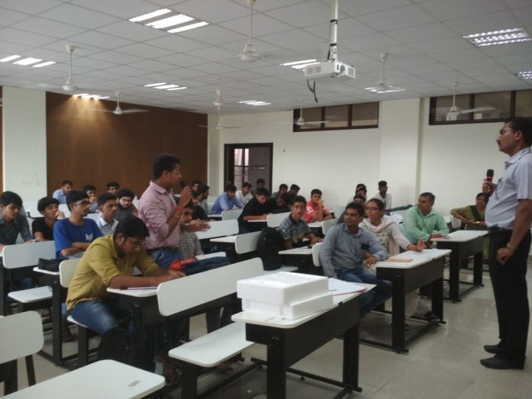
7. “Agriculture and Entrepreneurship” workshop with “Krushi Vigyan Kendra”, Surat District, at SVNIT, Surat
Aim: To educate students of SVNIT about agriculture and scope of business on farming.

Slide 51
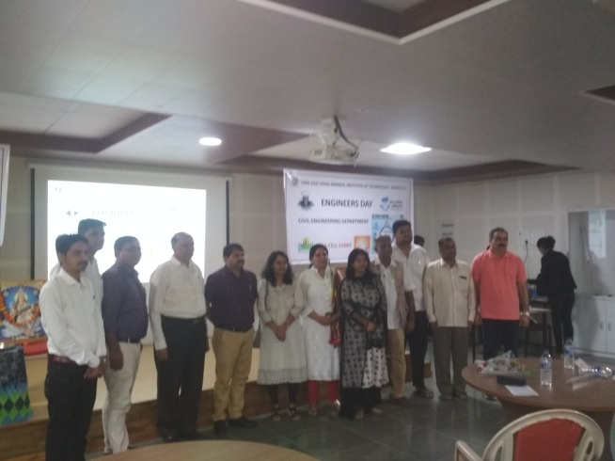
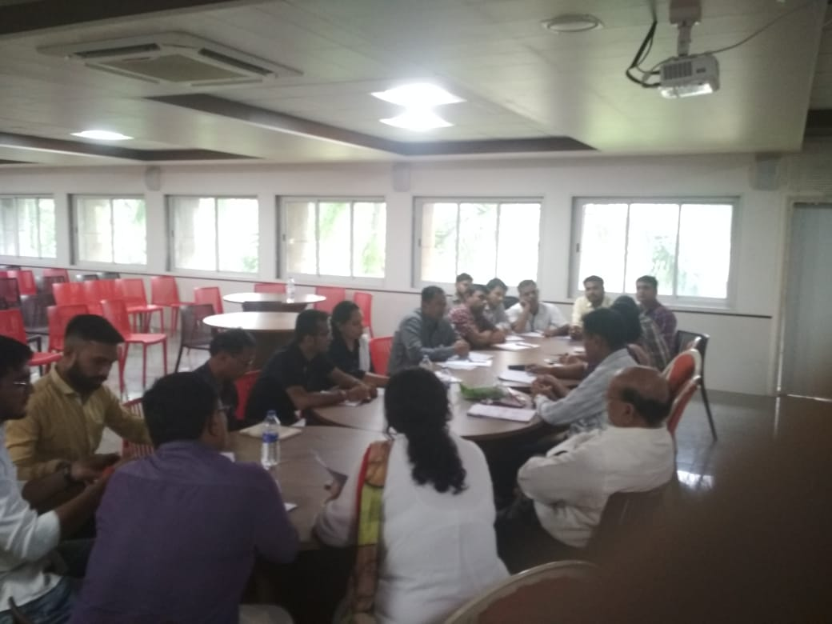
8. RCI SVNIT, Surat organized the “UBA Participating Institute Meeting” at SVMIT, Bharuch
Objective of activity: To review the work progress status from all Participating Institutes and solving various issues / problems raised from PIs of Regional Coordinating Institute SVNIT, Surat

Slide 52
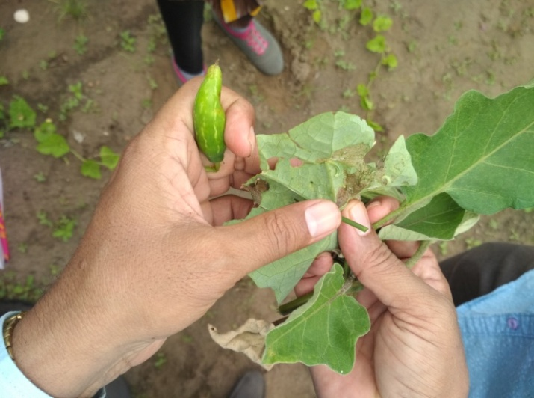
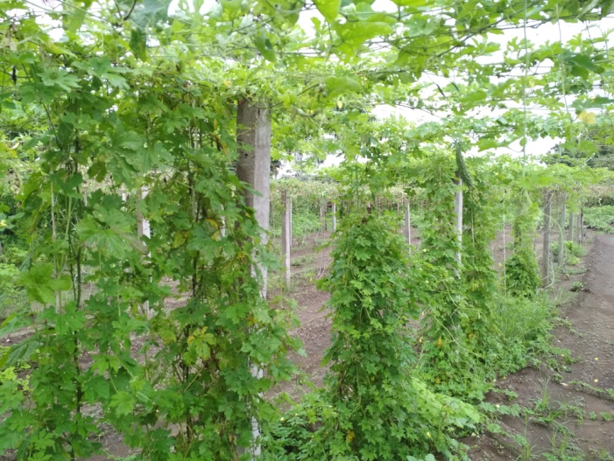
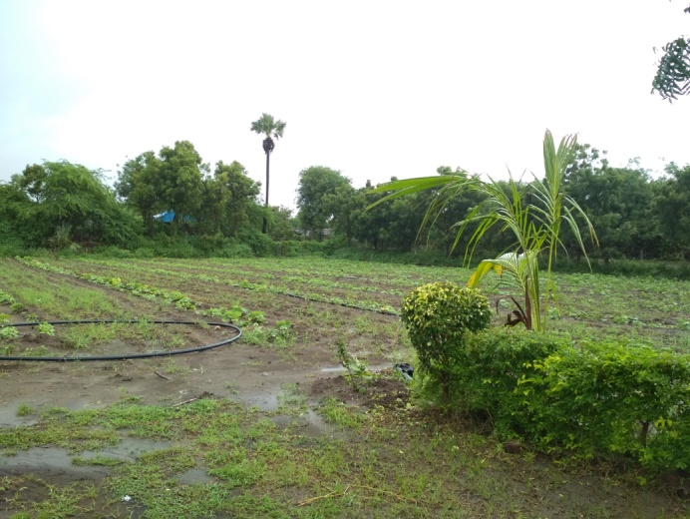
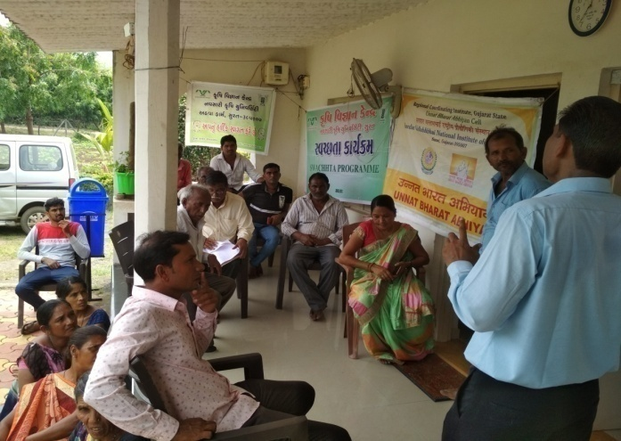
9. “Khedut Kalyan Karyashala” means “Farmer Welfare Workshop” at Suvali Village
Objective of activity: To give the solutions on pesticides and insecticides, season wise cropping style and other issues related to crop yield.

Slide 53
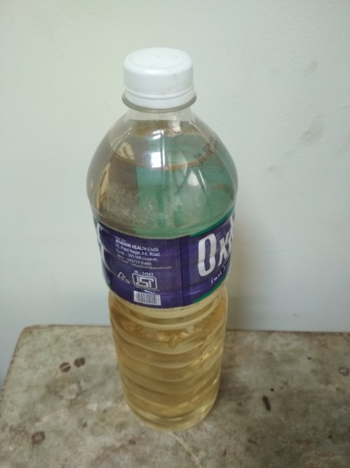
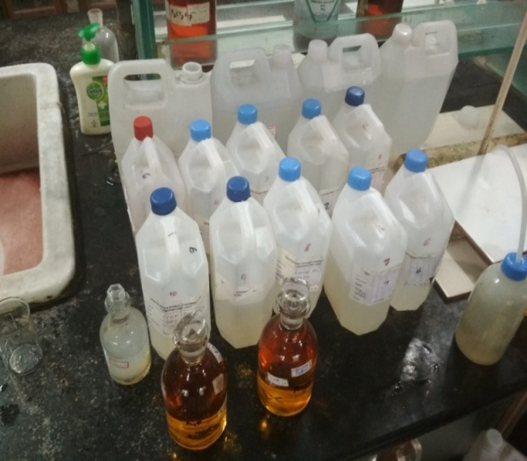
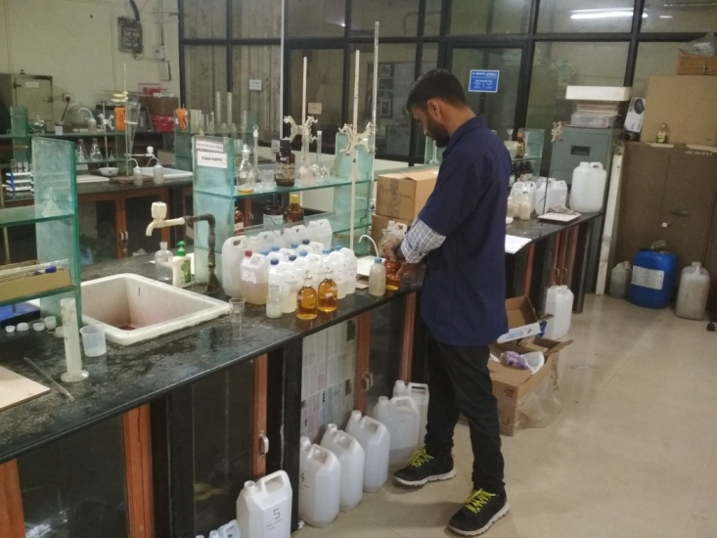
10. Testing of agriculture water supply from 10 different farms from Junagam
Village
Objective of activity: Checking the quality of agriculture water supply

Slide 54
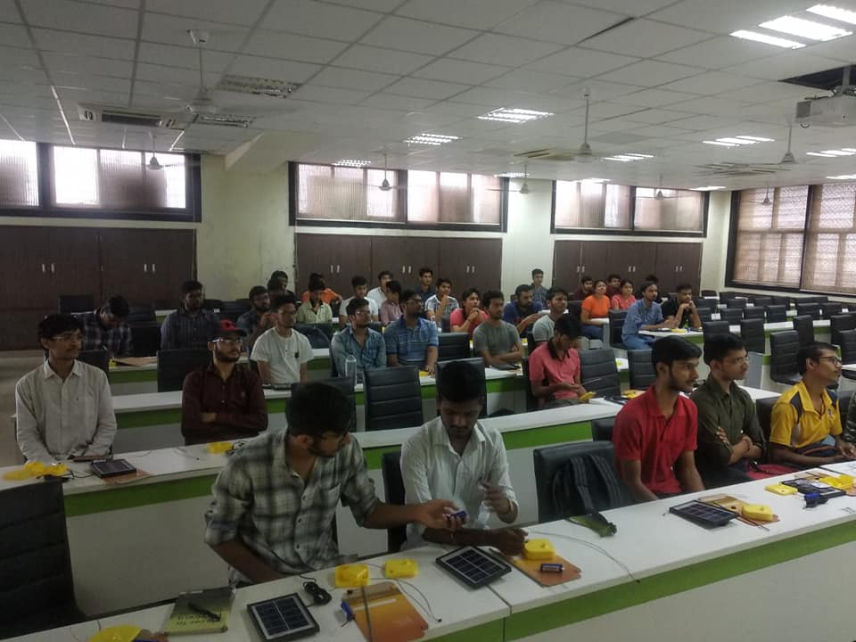
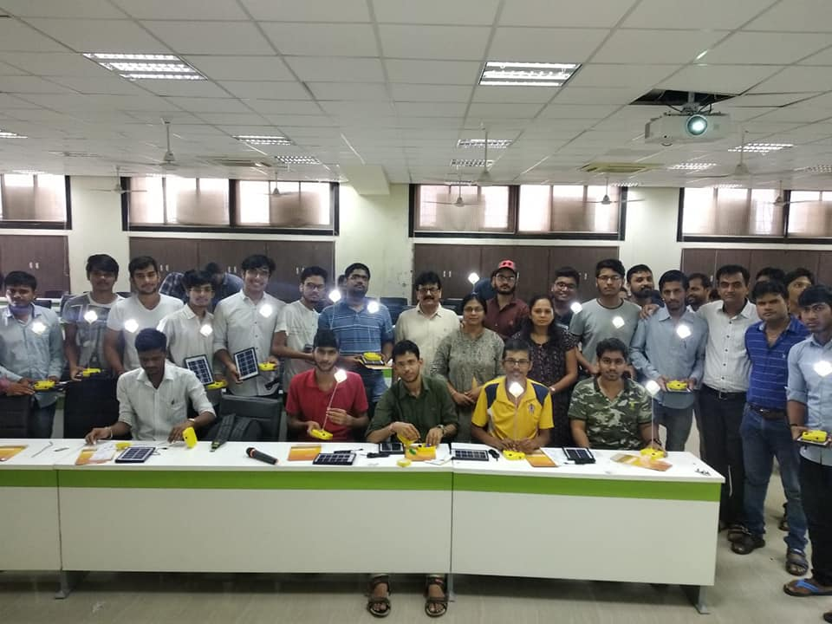
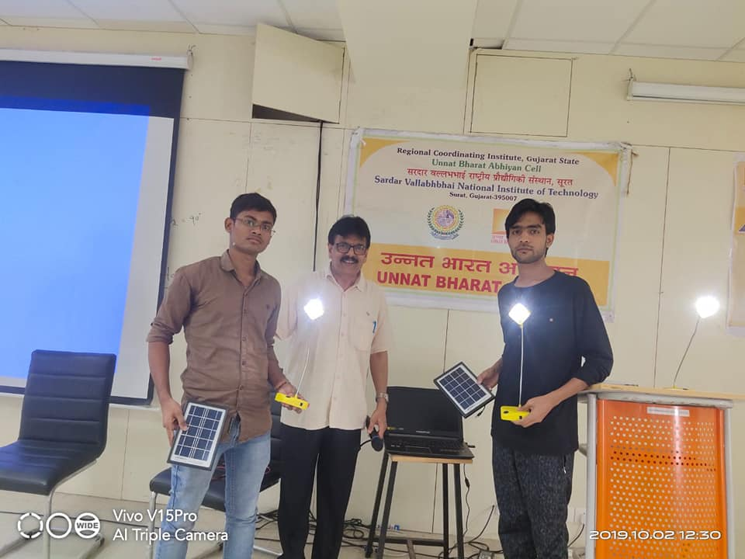
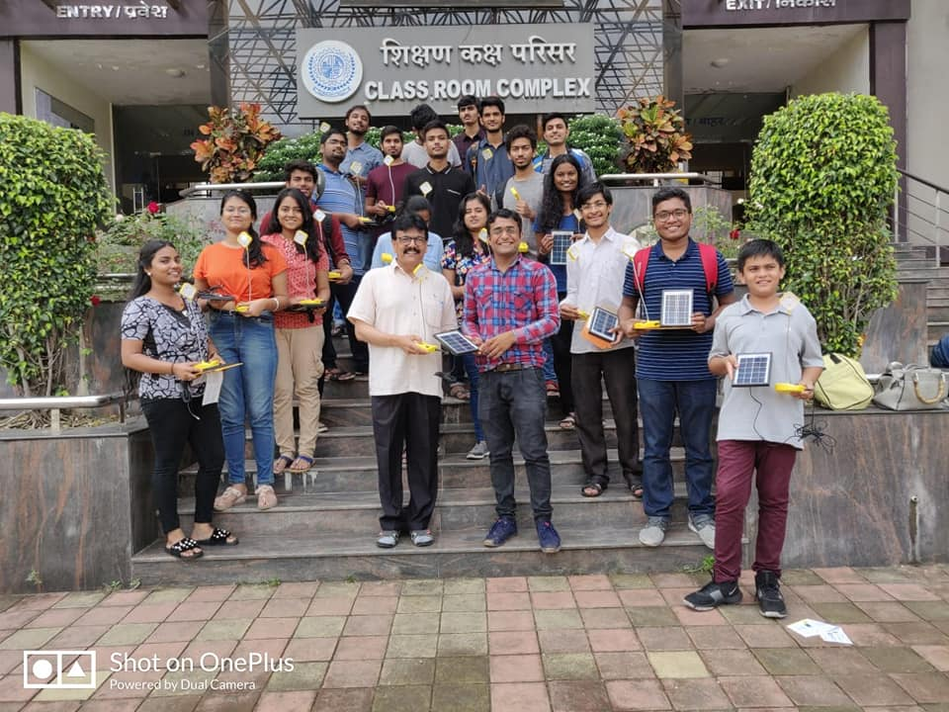
11. Organizing global event designed by IIT Bombay, “Student Solar Ambassador Workshop” at SVNIT, Surat.
The purpose of workshop is to sensitize the young minds towards solar energy and dire
consequences of climate change
Hands-on training will be given to 5. nos. of students to make their own solar study lamp.

Slide 55
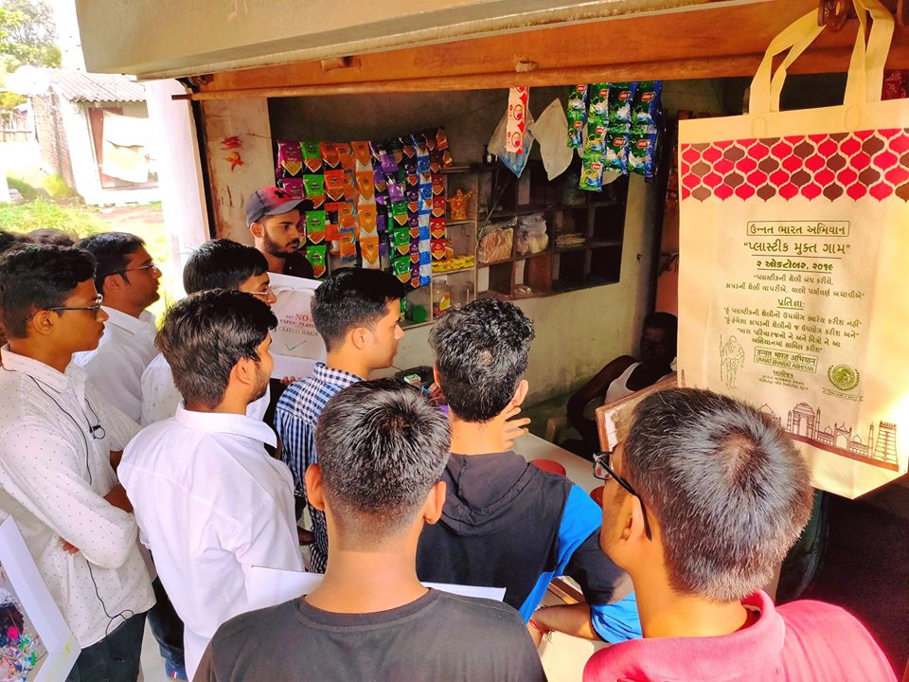
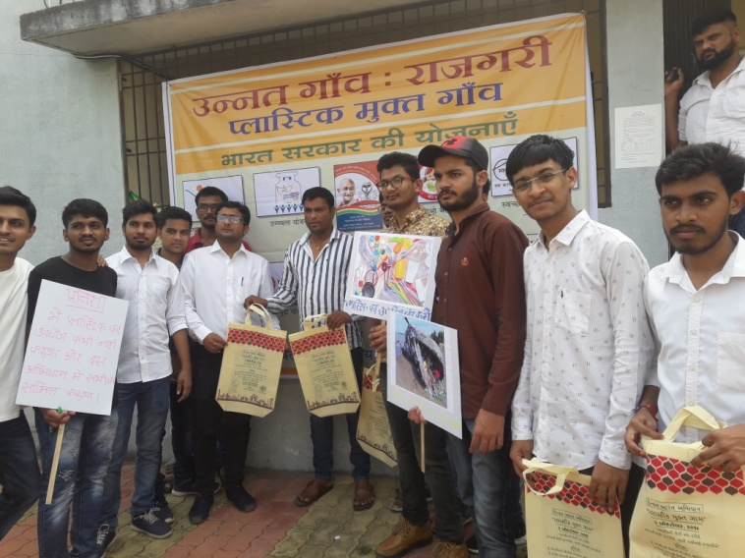
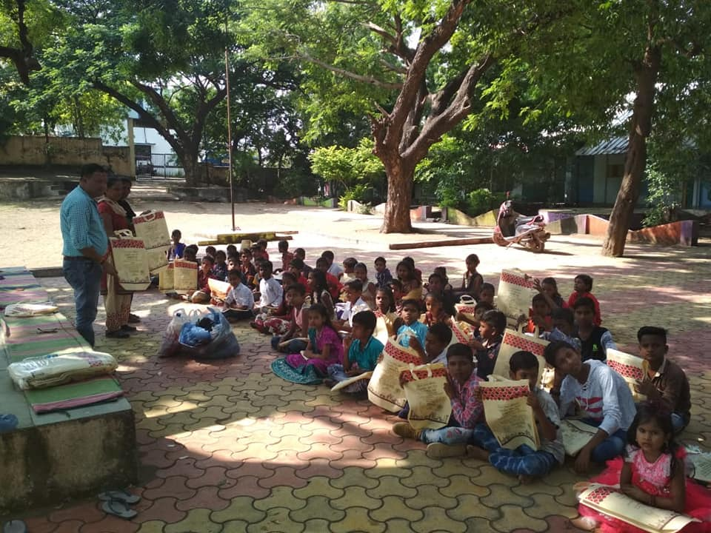
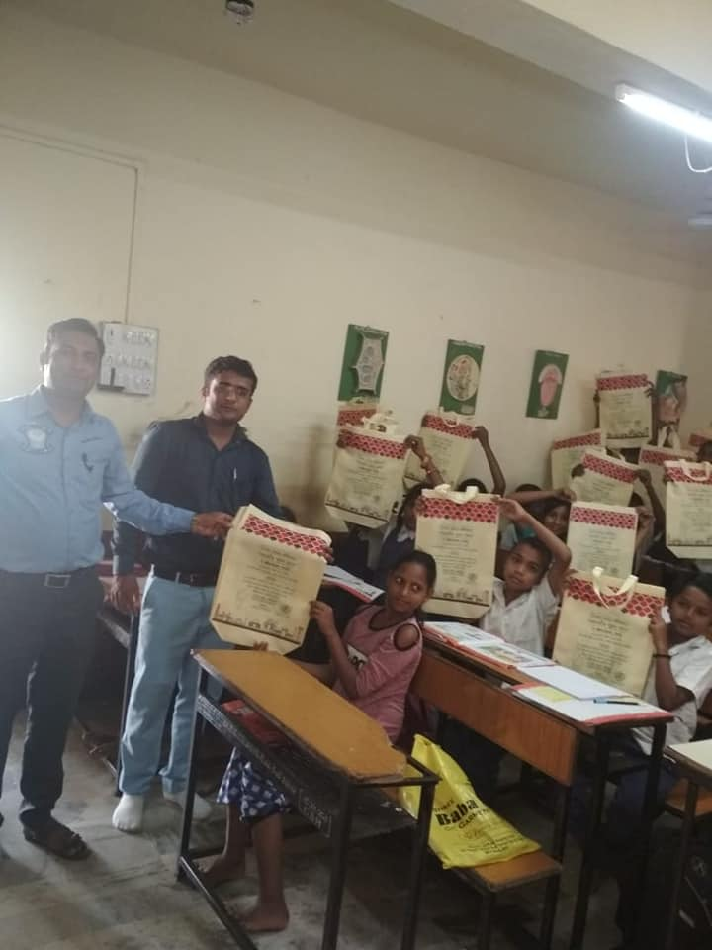
12. Organize “Plastic Free Village” campaign in Jilla Panchayat Schools of all 5 adopted
villages Mora, Bhatlai, Rajagari, Suvali and Junagam and “Plastic Free Campus:
SVNIT, Surat”.

Slide 56
13. Organized the “Student Development Workshop” for Jilla Panchayat Primary School of Rajagari, Rajagari Village.”

Slide 57
14. Organized a “Farmer Welfare Workshop” at Bhatali Village for disease & pest solution of various crops of villages

Slide 58
UBA activities by various Participating Institutes
Source: Unnat Bharat Abhiyan Website
Link:http://unnatbharatabhiyan.gov.in/documents

Slide 59
Contact Information
UNNAT BHARAT ABHIYAN
Website: http://unnatbharatabhiyan.gov.in/
Email address: unnatbharatabhiyaniitd@gmail.com
Prof. Virendra Kr. Vijay
National Coordinator,
Unnat Bharat Abhiyan
Room No. 376, Block-III,CRDT, Indian Institute of Technology Delhi,
Hauz Khas, New Delhi-110016
Regional Coordinating Institute SVNIT Surat
Dr. K. D. Yadav Dr. Manish K. Rathod Er. Jaydip N. Vora
UBA Regional Coordinator UBA Regional Co-coordinator UBA Manager
✆: +91 94283 98266 ✆: +91 99040 03856 ✆: +91 75674 24651
Email Address: rciuba@svnit.ac.in
Website: http://svnit.ac.in/Unnat_Bharat/
Ph.: 0261 220 4303
Address: 307, New CRC, SVNIT, Ichchhanath, Dumas Road, Surat

